Slide 1

Save Earth Pitch
Make wonderful discoveries with the help of AI
Adebayo Omolumo

Slide 2
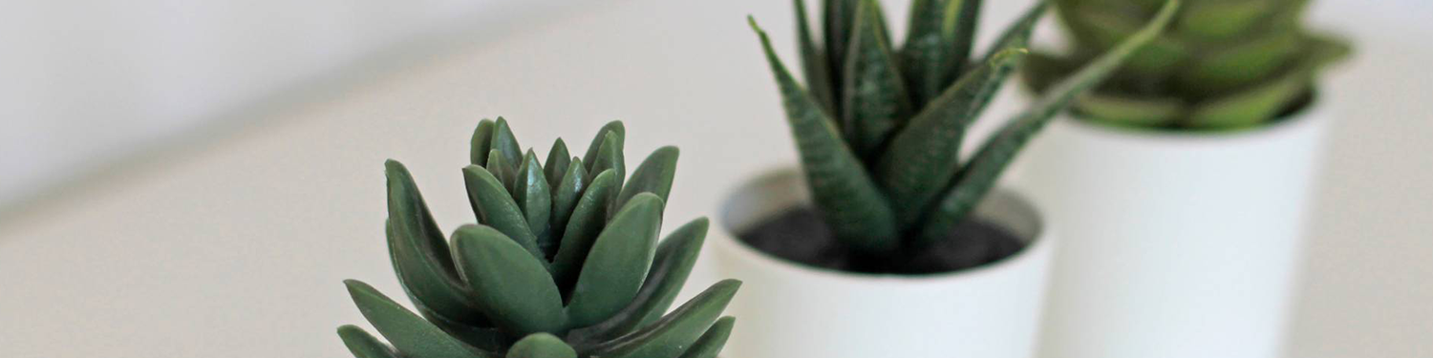
About us
At Save Earth, our goal is to create an interactive community that showcases the beauty and uniqueness of life on earth. We believe creating awareness about the effect humans have in their environment is the quickest way to reduce the damage by human pollution and improve conservation and climate. We achieve this by fostering collaborative thinking and participation.

Slide 3

Problem
Poor Conservation
Inclusivity
More than a quarter of plant and animal species around the globe are threatened with extinction.
An imbalance in participation of the impacted and vulnerable communities affected.
Lack of Data
Ripple Effects
Insufficient data to track rate of increase or decline of species in plants and animals
Depletion of organic matter in soil and migration of animals to urban areas may lead to soil crisis and health crisis respectively

Slide 4

Solution
Pay Per Discovery
Create alternate means of livelihood by paying for discovered priority images
Target audience
Create awareness in a way Gen Z (18-25 years old) would relate to. How? NFTs!
Break Barriers
Engage in discussions with local communities on conservation and climate change. conservation
Easy to use
Simple design that gives customers the targeted information they need

Slide 5

Product overview
AI
Blockchain (NFTs)
Our application uses an image classification iteration to help discover rare priority images that are of interest.
Users may decide to list their discoveries as NFTs.
Community Participation
3D/ AR / VR
First beautifully designed to immerse you into the artwork that is nature.
We encourage experts on the field from around the world to contribute their knowledge and insights

Slide 6

Product benefits
Users get paid after making discoveries on prioritized interest
Avenue for community connections
Online store and market swap for NFTs

Slide 7
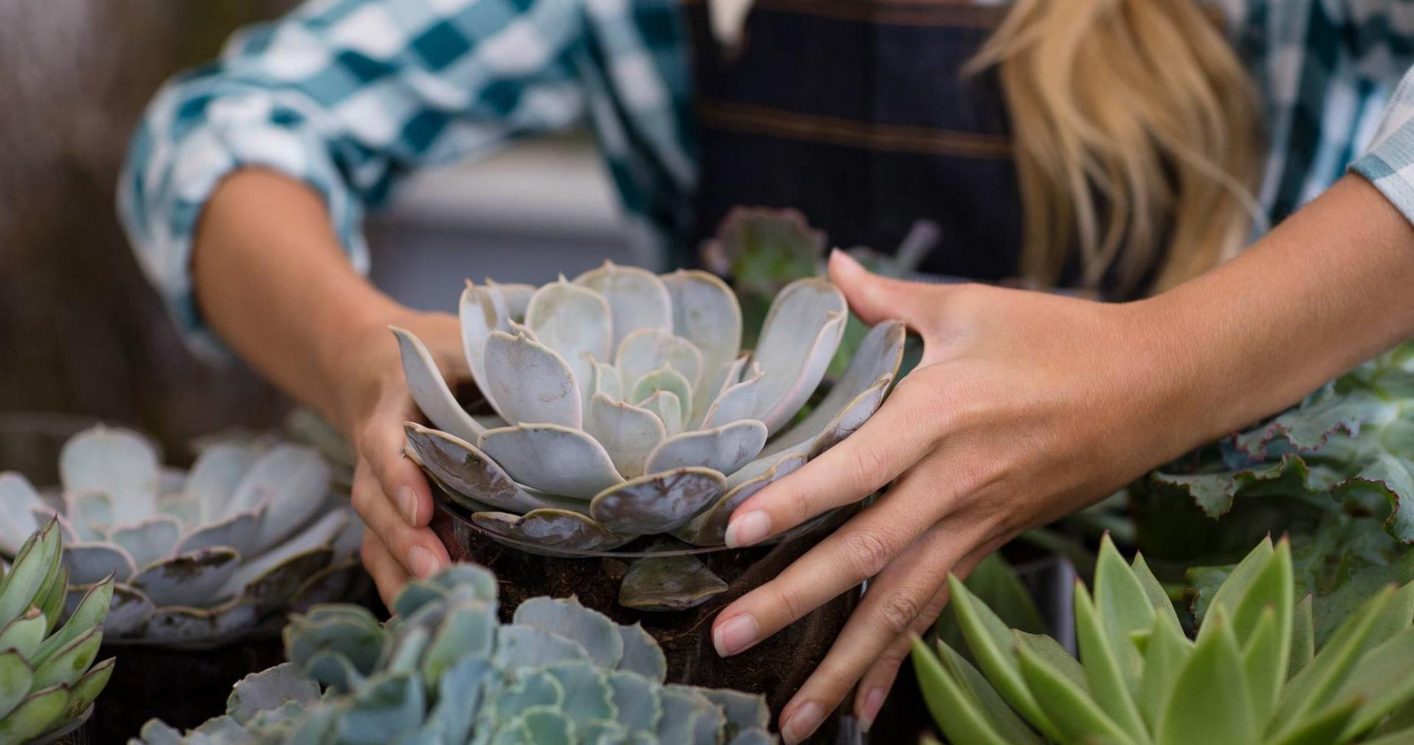
Company overview

Slide 8



Business model
Research
Abstract
Design
We based our research on market trends and social media. Inclusivity drives community.
To foster participation in conservation practices. And we base our products more on trends
Easy to use

Slide 9
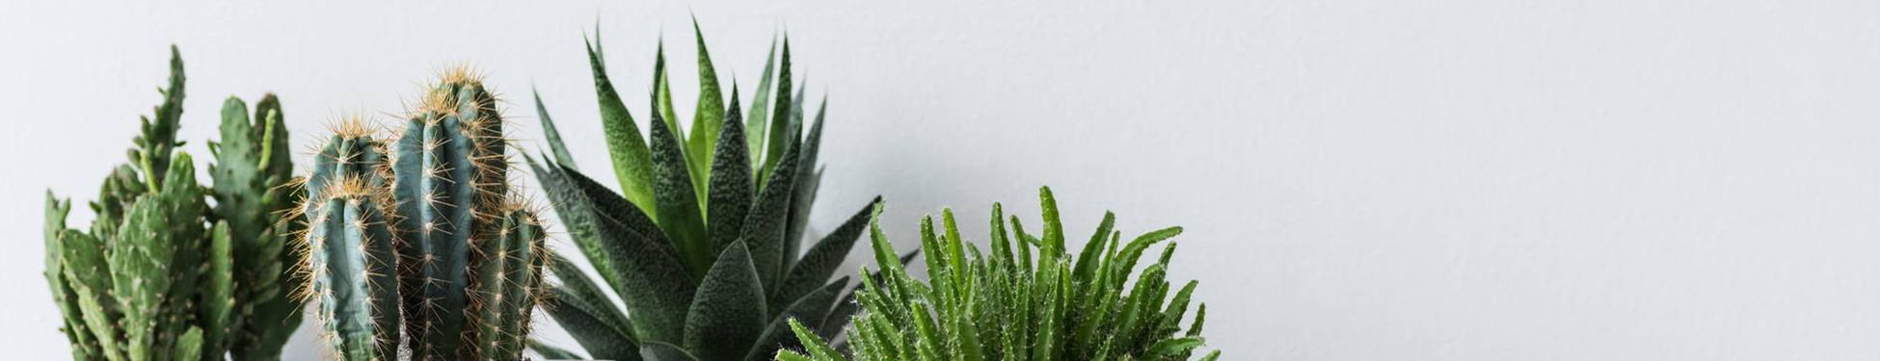
Market overview(NFTs)
$41B
$25B
$ 0.2B
Opportunity to build
Fully inclusive market
Total addressable market
Freedom to invent
Selectively inclusive market
Serviceable available market
Few competitors
Specifically targeted market
Serviceable obtainable market

Slide 10

Our competition
Save Earth
Competitors
Our product is focused on how to create awareness on conservation and the environment through the artist that is Mother Nature.
Unique in the sense that it highlights the beauty and rarity of nature.
Most NFT marketplace are generated artwork, collectible based.
Opensea and Rarible products are more general and monotone.

Slide 11
Competitive layout
Discovery Based
Save Earth
General
Unique
SuperRare
OpenSea
Rarible
Axie
Art Based

Slide 12
Growth strategy
How we’ll scale in the future
Feb 2022
May 2022
Oct 2022
Roll out product to a selective number of participants to help establish the product and encourage marketing using NFT rewards
Release the product to the general public and monitor press release and social media accounts
Gather feedback and adjust product design as necessary

Slide 13
Two-year action plan
Draft blueprints
Run focus groups
Gather more feedback
2023
JAN
FEB
MAR
APR
MAY
JUN
JUL
AUG
SEP
OCT
NOV
DEC
2024
JAN
FEB
MAR
APR
MAY
JUN
JUL
AUG
SEP
OCT
NOV
DEC
Test new designs
Relaunch design
Deliver to client

Slide 14
Financials
 | Year 1 | Year 2 | Year 3
Income
Donation | 50,000​ | 400,000​ | 1,600,000​
Users (Premium) | 50,000​ | 400,000​ | 1,000,000​
Sales (% NFT sale/swap) | 200,000​ | 4,000,000​ | 16,000,000​
Subscription | 75​,000 | 300,000 | 1,200,000
Gross profit | 375,000 | 5,100,000 | 19,800,000
Expenses
Sales & marketing | 5,500​ | 15,000​ | 50,000​
Customer service | 4,500​ | 10,000​ | 40,000​
Product development | 22,500​ | 100,000​ | 1,800,000​
Research | 10,250​ | 70,000​ | 620,000​
Total Expenses | 42,750 | 195,000 | 2,510,000​

Slide 15
Meet the team
Adebayo Omolumo
Adeife Omolumo
Developer
Product Development and Brand
Microsoft certified Cloud Developer with extensive experience in full-stack development
A certified arbitrator with a budding interest in corporate commercial law, conflict resolution, intellectual property, and project finance.

Slide 16
Funding
Raised Capital
Cloud Credits
$14,000
$12,000
Donation in cloud credits

Slide 17

Summary
We understand the importance of creating a balance between people and nature. We are eager to help create a web-based solution that includes, among many, the use of AI to help keep track of rare and endangered species, smart contracts which will help facilitate automatic rewards, provide remediation technologies, help facilitate good management practices, provide relevant educational materials and welcomes innovative solutions without barriers!

Slide 18

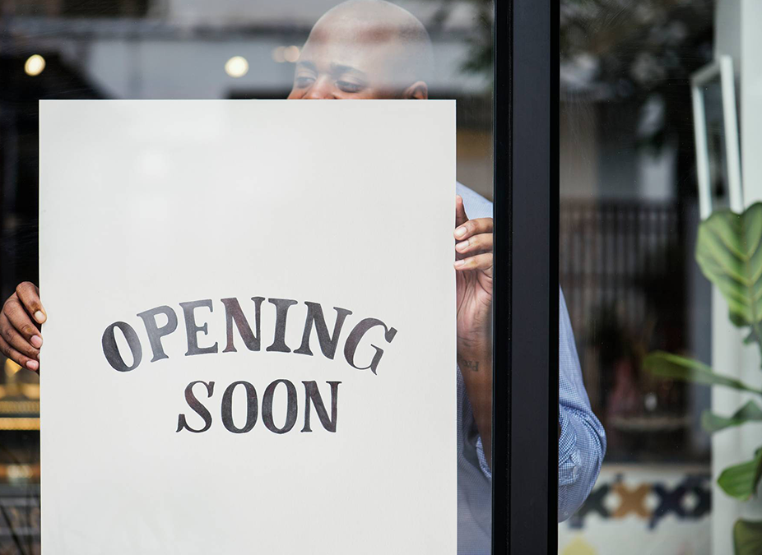
Thank you
Adebayo Omolumo​
+234 816 603 9145
bayurzx@gmail.com
Demo Site: TBD

